Slide 1
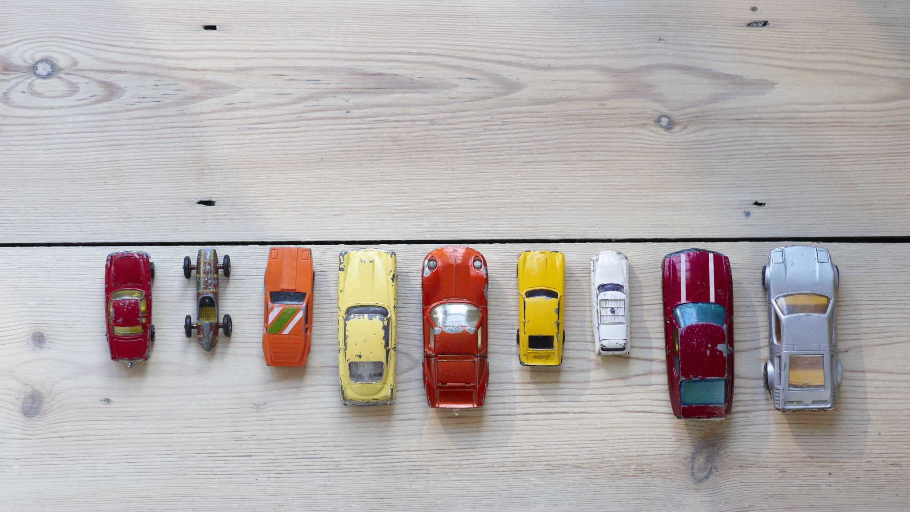
CO₂ Emissions of Different Car Models
Zaid Al-Jawadi

Slide 2
Problem Overview
How can we predict CO₂ emissions of a car?
Potential Impact:
Quantify CO₂ emissions for a given car
Potentially quantify vehicular CO₂ emissions in a city

Slide 3
Dataset and Preprocessing
Target variable: CO₂ emissions (g/km)
Features:
Car year
Car make
Vehicle class
Engine size (L)
Fuel Type
Transmission
Cylinders
Fuel consumption (city/hwy/combined)
Smog rating
CO₂ rating
Car Model

Slide 4
Preprocessing and EDA
Strong positive correlation between CO₂ emissions and:
Fuel consumption
Engine size
Cylinders
Bigger vehicles emit more CO₂

Slide 5
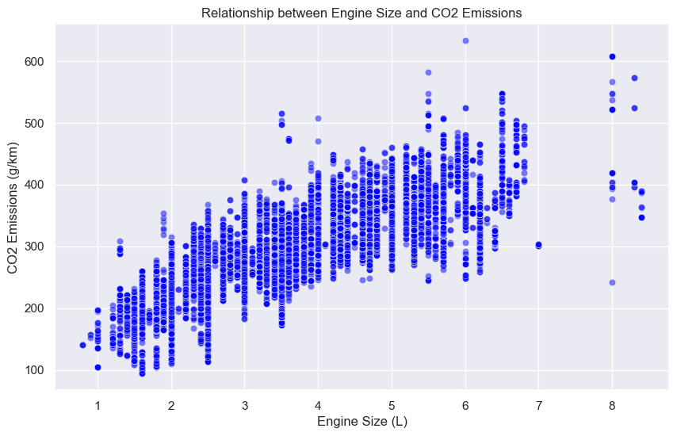
Preprocessing and EDA

Slide 6
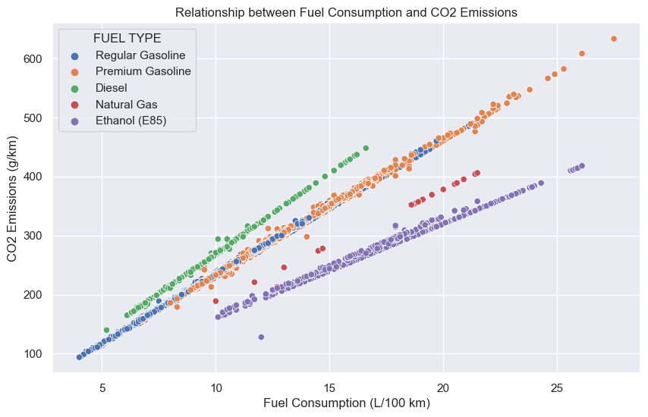
Preprocessing and EDA

Slide 7
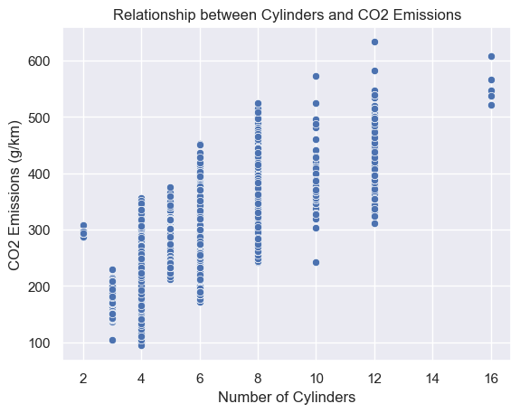
Preprocessing and EDA

Slide 8
Features Used for Modeling
Fuel consumption combined (L/100 km)
Engine size (L)
Number of cylinders
Fuel type

Slide 9

Modeling
Models performed:
Linear Regression
Ridge Regression
Lasso Regression
kNN
SVR
Random Forest

Slide 10
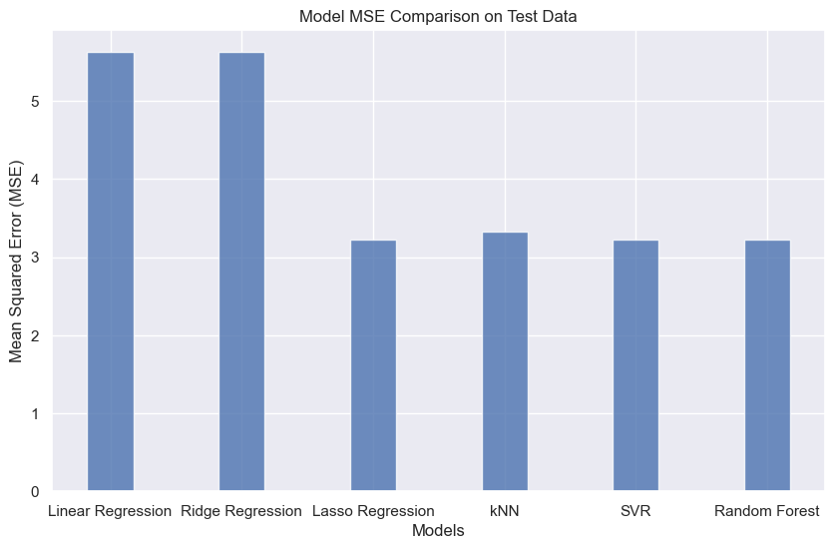
Modeling
Median CO₂ emissions: 268 g/km
Mean CO₂ emissions: 276 g/km

Slide 11
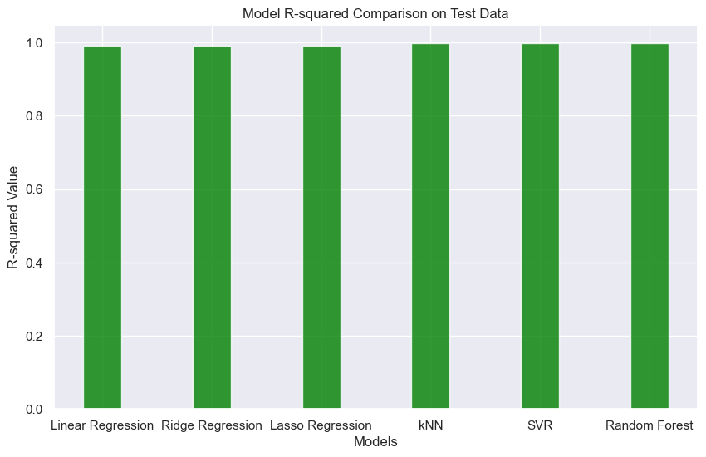

Slide 12
Conclusion and next steps
All models performed well
Car features that impact CO₂ emissions:
Fuel consumption (L/100 km)
Engine size (L)
Fuel type
Number of cylinders

Slide 13

Thank you!

